Slide 1
A Study Of The Book Of Revelation
March 28, 2021

Slide 2

Revelation 14:13
Revelation 14
“And I heard the voice from heaven saying, Write, Blessed are the dead who die in the Lord from henceforth: yea, saith the Spirit, that they may rest from their labors; for their works follow with them.”

Slide 3
Revelation 14
Christian’s triumph. Revelation 14:13
Rewarded for steadfastness (Chapters 20-22)
A “voice from heaven …”
“Blessed are the dead who die in the Lord”
“That they may rest from their labors”
“For their works (deeds) do follow them”
What do you take with you when you die? cf. 2 Peter 1:5-11
Contrast: Revelation 14:8-12

Slide 4
Contrast
Revelation 14
Emperor Worshippers Judged. Revelation 14:8-12
Christian’s Triumph. Revelation 14:13
Cursed … He will “drink of the wine of the wrath of God.”
“unmixed” – full strength nothing held back!
“He will be tormented with fire and brimstone”
“and the smoke of their torment goeth up for ever and ever; and they have no rest day and night”
“Blessed are the dead who die in the Lord”
“That they may rest from their labors”
“For their works (deeds) do follow them” (cf. 2 Peter 1:5-11)

Slide 5
Revelation 14
Revelation 14:14-20
Judgment is coming!
Reaping takes place.

Slide 6
Revelation 14:14
Revelation 14
Daniel 7:13
“And I saw, and behold, a white cloud; and on the cloud (I saw) one sitting like unto a son of man, having on his head a golden crown, and in his hand a sharp sickle.”

Slide 7
Revelation 14:15
Revelation 14
“And another angel came out from the temple, crying with a great voice to him that sat on the cloud, Send forth thy sickle, and reap: for the hour to reap is come; for the harvest of the earth is ripe.”
Angel #4
Daniel 7:13

Slide 8
Revelation 14:16
Revelation 14
“And he that sat on the cloud cast his sickle upon the earth; and the earth was reaped.”
Daniel 7:13
Revelation 1:7

Slide 9
Sickle of Judgment – As Viewed by the Righteous
Revelation 14
Please keep in mind; this is NOT the scene of the final judgment, NOT the scene of the fall of Jerusalem, but a judgment against “Babylon.” (ROME)
When? The announcements of the first three angels have been fulfilled.
This is the execution of God’s wrath over Rome.
The “one sitting on the cloud” having a “golden crown” and a “sharp sickle” is “one like unto a son of man” (Daniel 7:13)

Slide 10
Sickle of Judgment – As Viewed by the Righteous
Revelation 14
Angel announces “The harvest is right for reaping”
This first harvesting (grain) seems to refer to gathering righteous ones. (Matthew 3:12; 9:37-38; John 4:35-38)
God’s messenger announces that the time for righteous judgment has arrived.
Signals deliverance / vindication, for the righteous and defeat for the forces of evil (those who had tormented God’s children.)
This “reaping” is fearful for those who had been with the beast!

Slide 11
Revelation 14:17
Revelation 14
“Another angel came out from the temple which is in heaven, he also having a sharp sickle.”
Angel #5

Slide 12
Revelation 14:18
Revelation 14
“And another angel came out from the altar, he that hath power over fire; and he called with a great voice to him that had the sharp sickle, saying, Send forth thy sharp sickle, and gather the clusters of the vine of the earth; for her grapes are fully ripe.”
Angel #6
Genesis 15:16; Deuteronomy 9:4-5

Slide 13
Revelation 14:19
Revelation 14
“And the angel cast his sickle into the earth, and gathered the vintage of the earth, and cast it into the winepress, the great (winepress), of the wrath of God.”

Slide 14
Revelation 14:20
Revelation 14
“And the winepress was trodden without the city, and there came out blood from the winepress, even unto the bridles of the horses, as far as a thousand and six hundred furlongs.”

Slide 15
Sickle of Judgment – The Fifth And Sixth Angels: The Time Is Come To Reap The Wicked (14:17-20)
Revelation 14
Another angel out of heaven, out of the temple, which is in heaven
“Thrust a sickle” (judgment)
Gathered the grapes
Threw them into the great winepress
Trampled without the city
GREAT JUDGMENT … Blood came out of the winepress (for 200 miles)! NOTHING LITERAL! cf. Joel 3:9-17 (Nations); Isaiah 63:1-6 (Edom); Lamentations 1:15 (Judah)

Slide 16
Sickle of Judgment – The Fifth And Sixth Angels: The Time Is Come To Reap The Wicked (14:17-20)
Revelation 14
Another angel out of heaven, out of the temple, which is in heaven
“Thrust a sickle” (judgment)
Gathered the grapes
Threw them into the great winepress
Trampled “without the city” (verse 20)
What City?
Literal Jerusalem? “The Romans trod upon Jerusalem from the outside of the city as their weapons of war constantly bombarded its inhabitants with arrows, darts and stones until every drop of blood within it was removed … The language is symbolic, yet it conforms somewhat to the literal descriptions given by Josephus of the destruction of the city.” (Arthur M. Ogden, The Avenging of the Apostles and Prophets, Page 300)

Slide 17
Sickle of Judgment – The Fifth And Sixth Angels: The Time Is Come To Reap The Wicked (14:17-20)
Revelation 14
What City?
Others prefer to interpret this city as spiritual “heavenly Jerusalem.”
“As the bodies of the sin-offerings were burned outside of the camp, and as a sin-offering Jesus ‘suffered without the gate’ (Heb. 13:11f); so it is appropriate that the world that rejected Him and His salvation should be trodden without the city. The blood which came out of the winepress to a depth reaching the horses bridles, and extending as far as sixteen hundred furlongs, about two hundred miles, is quite difficult to explain. Literalism is ruled out by the whole picture. If old physical Jerusalem is the city in the vision and the area of Palestine is the lake, one cannot interpret the picture literally because that territory is not two hundred miles long or wide; also, the low depth of twelve hundred ninety feet below sea level at the Dead Sea makes any literal interpretation impossible. Probably the picture intends to indicate the magnitude and completeness of the judgment.”
(Homer Hailey, Revelation – An Introduction and Commentary, Pages 315-316)

Slide 18
Sickle of Judgment – Viewed by the Unrighteous
Revelation 14
Gathered the clusters and cast them into the “winepress” of the Almighty!
Reflects a single event of divine judgment against Rome
Came out of the altar – why?
Final response to the saints prayers seeking vindication! (Revelation 6:9ff)

Slide 19
Sickle of Judgment – Viewed by the Unrighteous
Revelation 14
Not wine, but blood, flowing from the winepress …
Heaven’s judgments against Rome would be severe!
Treading the winepress of God’s wrath in time brought the Roman Empire (Revelation 13:1), its provincial kings, and Roman paganism (Revelation 13:11) to an end!
Total destruction awaits those who oppose God and His people!
For those who find themselves “beyond the pale of divine protection”

Slide 20
Review
Revelation 14
Six angels …
Four great banners of coming events …
Two sickles of judgment …
Wicked and righteous have two totally different futures …
Consequences for both groups …
One is far better than the other!

Slide 21
Review
Revelation 14
Chapter 12 describes a battle with Satan.
Chapter 13 describes Rome (an ally or tool of Satan) failing.
Two Beasts
The Empire
Roman Concilia (Paganism).
Chapter 14 is a picture of victory for God and His people.

Slide 22
Contrast
Revelation 14
Emperor Worshippers Judged. Revelation 14:8-12
Christian’s Triumph. Revelation 14:13
CURSED! He will “drink of the wine of the wrath of God.”
“unmixed” – full strength nothing held back!
“He will be tormented with fire and brimstone”
“and the smoke of their torment goeth up for ever and ever; and they have NO REST day and night”
“BLESSED are the dead who die in the Lord”
“That they may REST from their labors”
“For their works (deeds) do follow them”
Choice is simple!

Slide 23
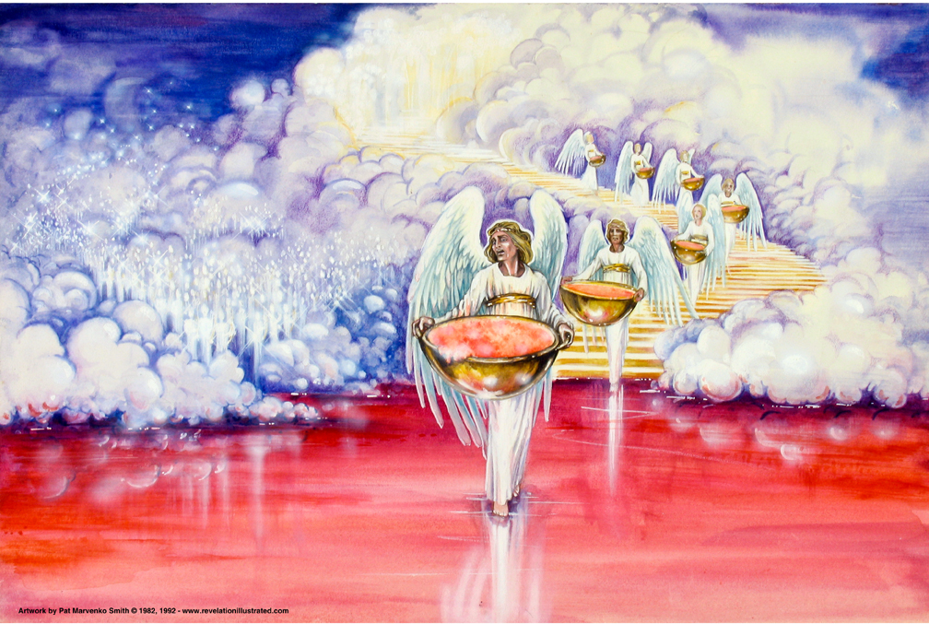
The Book of Revelation: Chapter 15
Interlude:
Song of Victory
Seven Plagues Anticipated!

Slide 24
Revelation
I. Struggle on Earth (1-11)
A. John’s Vision (1)
B. Letters to 7 churches (2-3)
C. God in control (4-5)
D. Opening of seven seals (6-11)

Slide 25
Revelation
II. Christ And The Dragon In Conflict (12-22)
(Deeper Spiritual Meaning)
A. War (12-14)
B. Bowls of Wrath (15-16)
C. Fall of Babylon the Harlot (17-18)
D. Victory of God’s people (19-21)
E. Warnings about the Book (22)

Slide 26
Revelation 15 and 16
“Seven Angels With Seven Bowls of Wrath”
Outline of Chapter 15
Seven Angels With Seven Plagues of Wrath (verse 1)
The Victorious Saints on the Sea of Glass (verses 2-4)
Those that overcame (verse 2a)
The beast
The image of the beast
The mark and number of the beast
Singing the song of Moses and the Lamb (verses 2b-4)

Slide 27
Revelation 15 and 16
“Seven Angels With Seven Bowls of Wrath”
Outline of Chapter 15
III. Seven Bowls of Wrath Given to the Seven Angels (verses 5-8)
Seven angels come out of the temple (verses 5-6)
One of the four living creatures gave seven bowls of wrath to seven angels (verse 7)
Temple filled with smoke of the glory of God (verse 8)

Slide 28
Revelation 15:1
Revelation 15
“And I saw another sign in heaven, great and marvellous, seven angels having seven plagues, (which are) the last, for in them is finished the wrath of God.”

Slide 29
Another Angel …
Revelation 15
Anticipation …
The angels and the seven plagues
Trumpets blown (chapters 8-11). Mercy mixed with wrath.
Only 1/3 part of men were given time to repent.
The narrow line between His mercy and wrath has been crossed.
Now His wrath will not be mixed with mercy!
God is a consuming fire!
Hebrews 12:29

